Slide 1


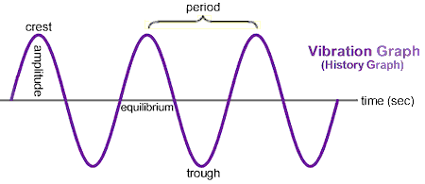







POWA Conference Poster Title
Author(s) • Organization(s) • Contact Information
Call for Posters
Template
Submission Requirements
Insert text, figures, tables, charts, screenshots, and references here.
Recommended font sizes:
Title: 80–100 pt
Headers: 32–40 pt
Body: 20–28 pt
Insert text, figures, tables, charts, screenshots, and references here.
Recommended font sizes:
Title: 80–100 pt
Headers: 32–40 pt
Body: 20–28 pt
Insert text, figures, tables, charts, screenshots, and references here.
Recommended font sizes:
Title: 80–100 pt
Headers: 32–40 pt
Body: 20–28 pt
Topics of Interest Include but Are Not Limited To:
Analysis of Incipient Faults & Asset Health Using POW Data
Novel Applications of POW Data Related to Power Quality Issues
Novel Applications of POW Data Related to Fault Analysis
Analysis and Detection of Geomagnetic Events with POW Data
Predictive Maintenance Applications Using POW Data
Wildfire Prevention & Detection Using POW Data
Monitoring of Datacenter Load Characteristics Using POW Data
Monitoring of Inverter-Based Resources Using POW Data
Sub-synchronous Oscillation Detection Using POW Data
Computer Simulation, Analysis & Modeling for POW Applications
Management (Compression, Transport, Storage, etc.) of Large POW Data Sets
Enhancement of Existing Decision Tools and Processes
Cyber-Security Related Applications
This Poster Template should be used for the POWA Conference Student Poster Session
All posters must use the provided poster template
Final posters must be submitted to the conference electronically as .ppt or .pdf by August 14th 2026
All posters must use the provided poster template
Minimum Font Size 18
Minimum Header Font Size: 24
The student author must be present at the student poster session, which will be held at the POWA Reception on September 29th 2026
Awards for best poster are announced during the second day of the conference (September 30th
This figure shows a generic waveform
Results
Insert text, figures, tables, charts, screenshots, and references here.
Recommended font sizes:
Title: 80–100 pt
Headers: 32–40 pt
Body: 20–28 pt
To Enter, Please Submit a Title and Brief Abstract and Include Contact Information for All Authors and a Faculty Advisor. Submit via Email to:
Merrick Walker, EPB
walkermg@epb.net
Christoph Lackner, GPA, clackner@gridprotectionalliance.org
Theo Laughner, LSA
tlaughner@lifescaleanalytics.com
Platinum Sponsors
Gold Sponsors
Silver Sponsors
Bronze Sponsors
2026 Point On Wave Applications (POWA) Conference

